Slide 1
Stochastic Methods

Slide 2
Stochastic Methods
Employ randomness strategically to help explore design space
Randomness can help escape local minima
Increases chance of searching near the global minimum
Typically rely on pseudo-random number generators to ensure repeatability

Slide 3
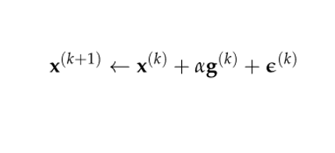
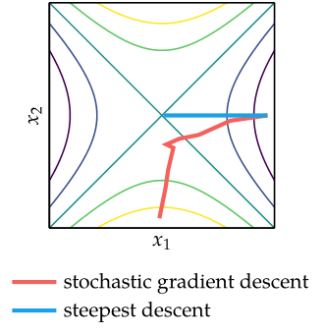








Noisy Descent
Gradient descent with additional random noise term
Step size must meet certain conditions to guarantee convergence

Slide 4






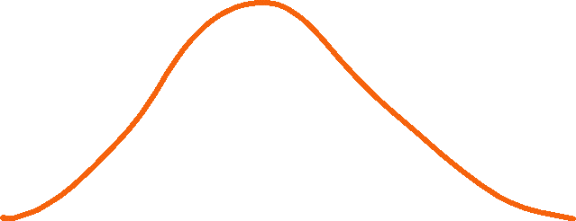








Slide 5
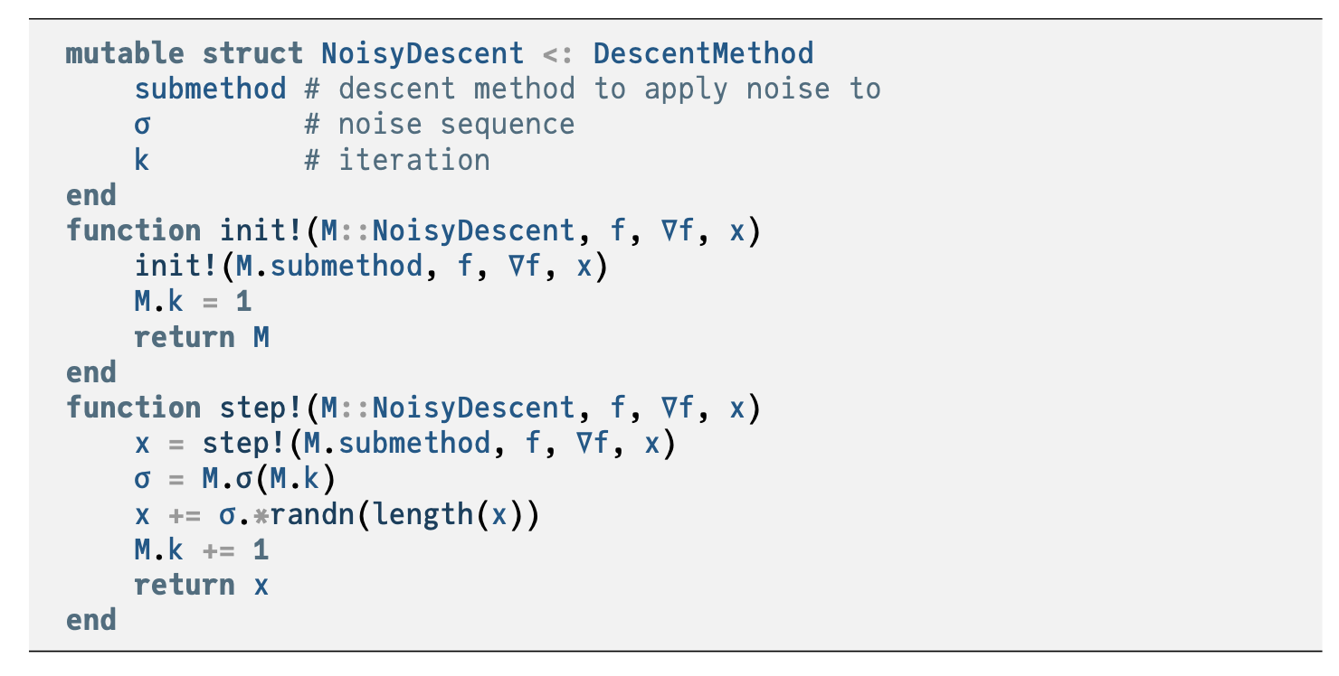





Slide 6
















Simulated Annealing
Intelligently controls the degree of randomness added to stochastic search methods
Randomness is analogous to temperature in metallurgy
Initially, the randomness added to function evaluations is large
The “temperature” is then slowly lowered according to a predetermined “annealing schedule”

Slide 7
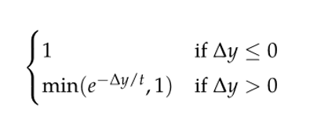



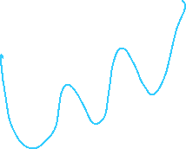


Simulated Annealing
Each step must then be “accepted” as the new design point with probability defined by the Metropolis criterion, helping the algorithm escape local minima
Metropolis criterion probability of acceptance

Slide 8
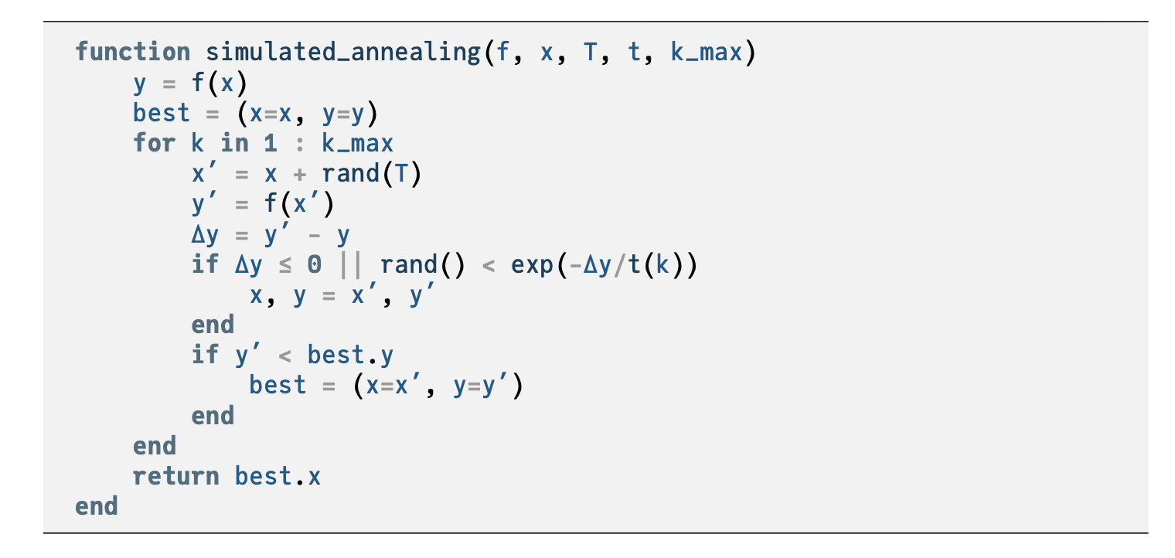





Slide 9
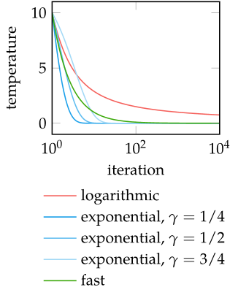
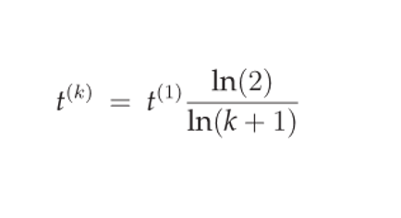
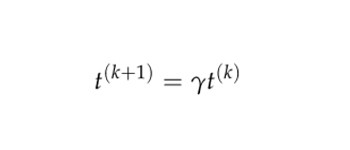




Simulated Annealing
Annealing schedules
Logarithmic annealing schedule
Exponential annealing schedule
Fast annealing

Slide 10
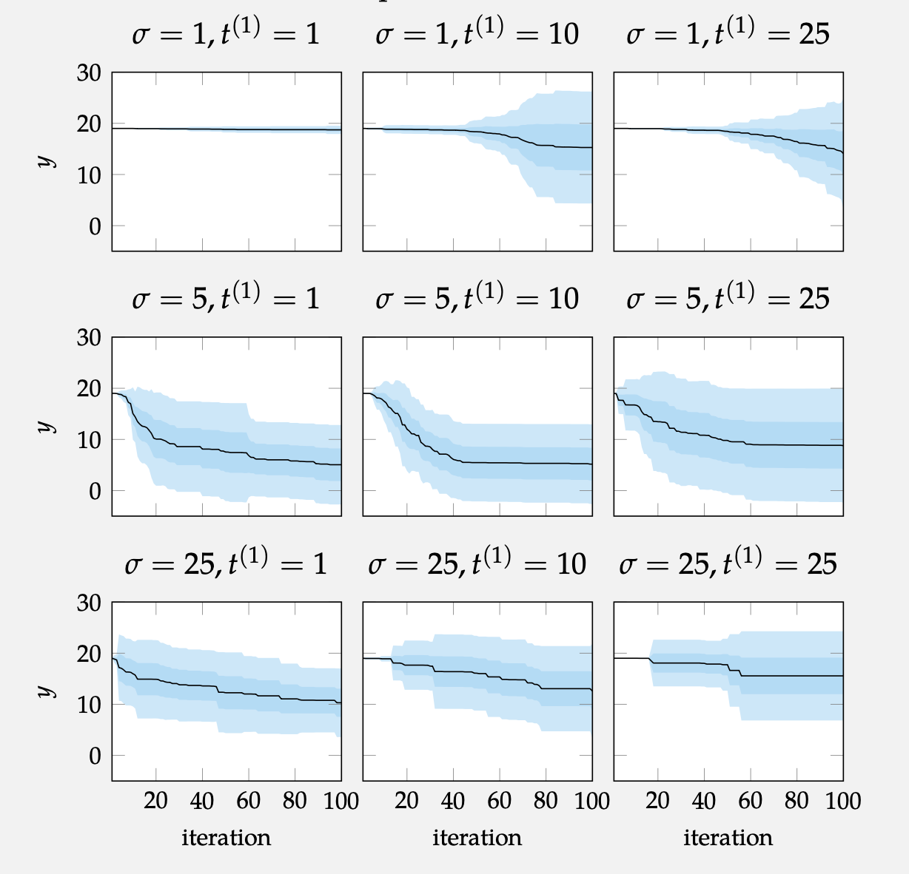

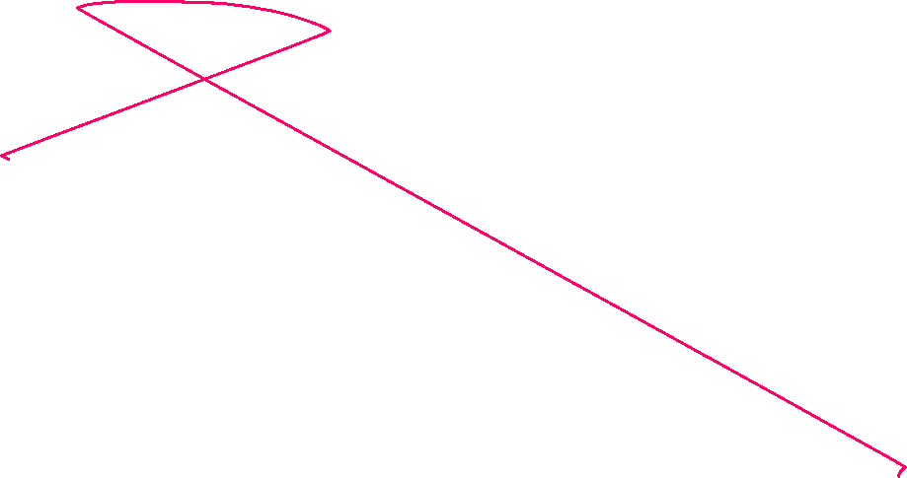





Slide 11

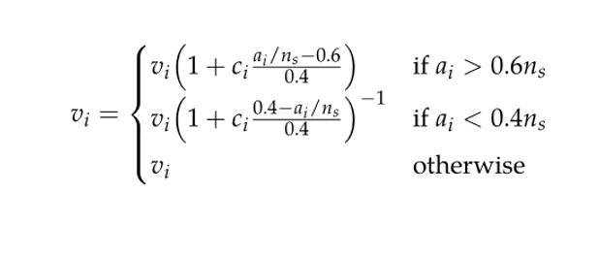


Simulated Annealing
Corana et al. 1987 introduced variable step-size
First, a cycle of random moves is performed in each direction
where r is randomly sampled from [-1,1]
After n_{s} cycles, step size is adjusted according to
where c is typically set to 2

Slide 12
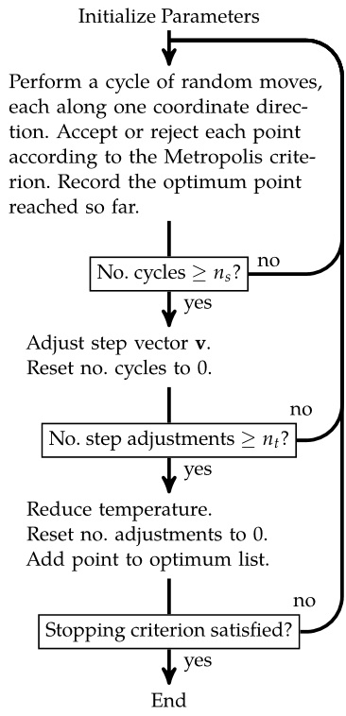
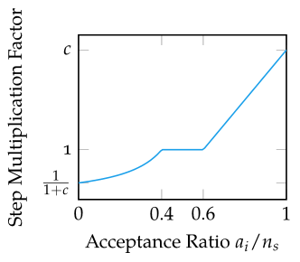
Simulated Annealing
The variable step size introduced by Corana et al. 1987 regulates the ratio of accepted-to-rejected points to about 50%

Slide 13






Slide 14

Cross-Entropy Method
Maintains explicit probability distribution over design space often called a proposal distribution
Requires choosing a family of parameterized distributions
At each iteration, a set of design points are sampled from the proposal distribution; these are evaluated and ranked
The best-performing subset of samples, called elite samples, are retained
The proposal distribution parameters are then updated based on the elite samples, and the next iteration begins

Slide 15

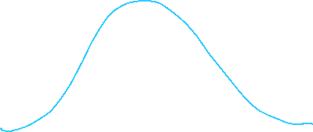


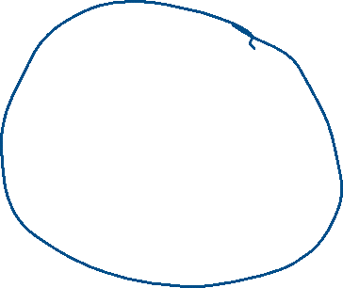


Slide 16
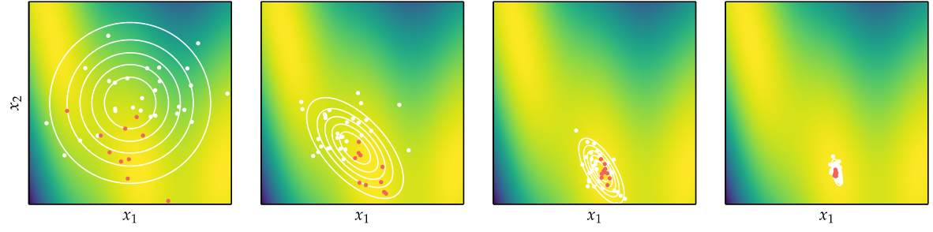
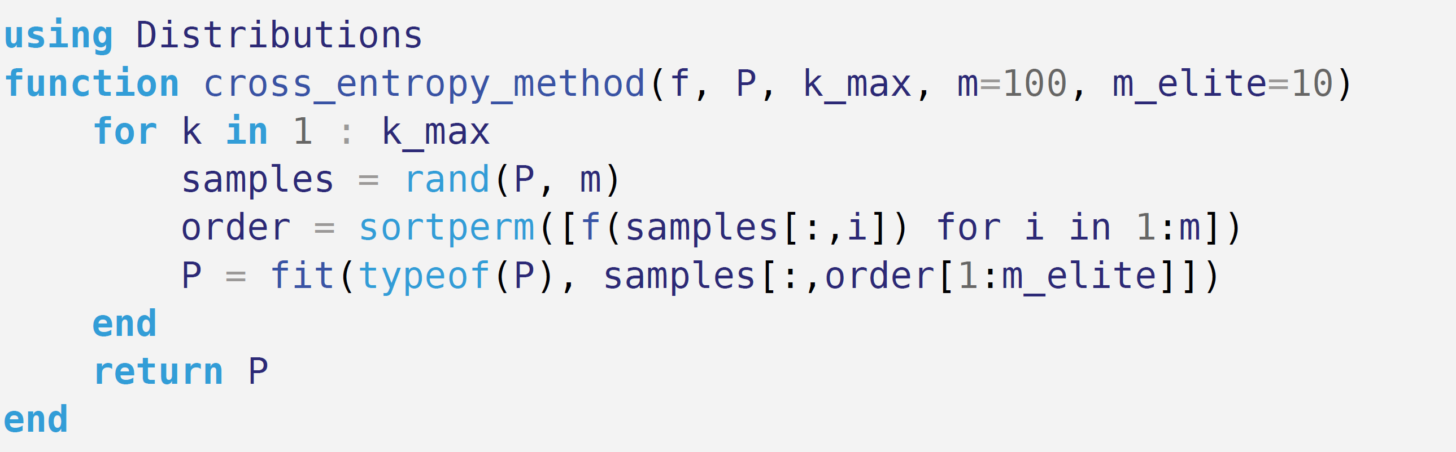










Cross-Entropy Method

Slide 17
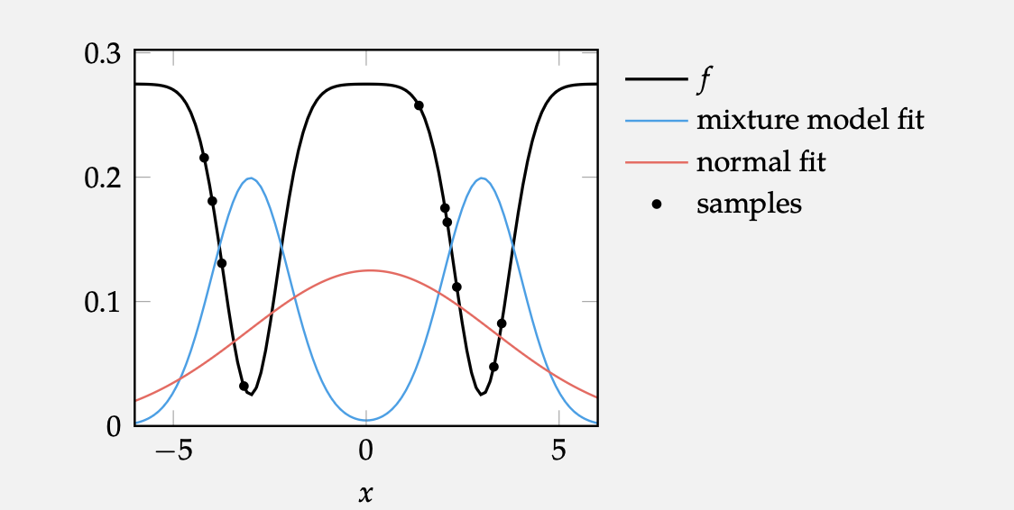















Slide 18
Summary
Stochastic methods employ random numbers during the optimization process
Simulated annealing uses a temperature that controls random exploration and which is reduced over time to converge on a local minimum
The cross-entropy method and evolution strategies maintain proposal distributions from which they sample in order to inform updates

Slide 19

Summary
Natural evolution strategies uses gradient descent with respect to the log likelihood to update its proposal distribution
Covariance matrix adaptation is a robust and sample-efficient optimizer that maintains a multivariate Gaussian proposal distribution with a full covariance matrix

